Slide 1
Introduction to Statistical Learning
Tianhang Zheng
https://tianzheng4.github.io

Slide 2
Notations (Supervised Learning)
Vector/Matrix/Tensor predictor X (also called inputs, regressors, covariates, features, independent variables)
Outcome Y (also called dependent variable, response, target)
Objectives:
Accurately predict the outcomes of unseen test cases
Understand which inputs affect the outcome, and how
Assess the quality of our predictions and inferences

Slide 3
Notations (Supervised Learning)
Task: Predict the income based on years of education, years of work, etc.
Outcome Y is Income
Predictors are years of education, years of work, etc. (Denoted by X)
Model: $Y=f\left(X\right)+ε$

Slide 4
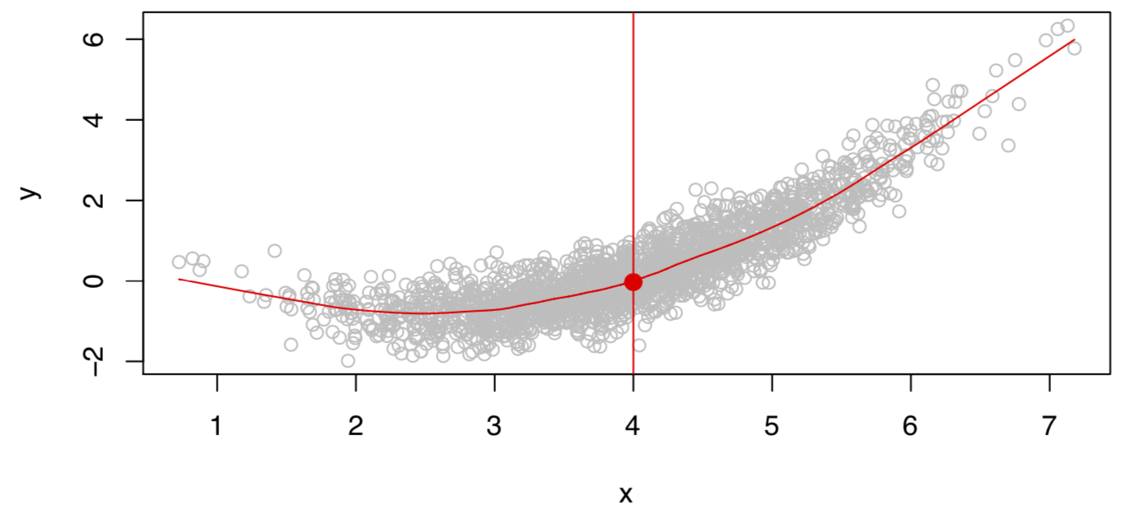
What is an ideal model?
Given X, there may be multiple outcomes Y due to different $ε$.

Slide 5
What is an ideal model?
The ideal model characterizes the expectation of the outcome.
$$f\left(X\right)=E(Y|X)$$
The ideal model is also called the regression function.
If $X$ is a vector, $X=[X_{1}, X_{2}]$
$$f\left(x\right)=E(Y|X_{1}=x_{1}, { X}_{2}=x_{2})$$

Slide 6






Implementation Tools

Slide 7
Python Resources
Kaggle: https://www.kaggle.com/learn/python
Learn Python: https://www.learnpython.org/
Python for Beginners by Microsoft: https://learn.microsoft.com/en-us/shows/intro-to-python-development/
Python for Everybody (up to 6 hours): https://www.youtube.com/watch?v=8DvywoWv6fI
Google it
Introduction to Python (next course)

Slide 8
Course Website
https://tianzheng4.github.io/umkc-teaching/2023-fall-teaching-1/
What are on the course website:
Lecture slides
Lab material
Contact Information
If you are interested in my research, feel free to contact me.

Slide 9
Q & A

